Slide 1

A Reconfigurable Arduino Crypto FPGA Shield
| Dustin Schnelle |
| Gomathy Venkata Krishnan |
| Meiqi Zhao |
| Ryan Bornhorst |
Notes:
Meiqi start

Slide 2

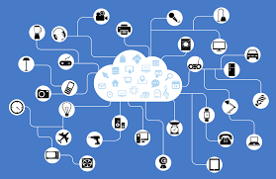
Background
Arduino’s impact on the Internet of Things
Embedded systems are rarely designed with security as a first priority
Security flaws are costly
$1.3M for large companies
(2017 report from Kaspersky Labs)
An exponential growing number of vulnerabilities
783 data breaches in the US
(2014 rom Identity Theft Resource Center’s Breaches Report)
Bowerman, K. (2017). Homeland Security Technologies for the 21st Century. [online] Google Books.
Cooper, C. (2017). What is the Cost of a Breach?. [online] CSO Online.
Notes:
http://www.hddesktopbackgrounds.us/backgrounds-images/1920x1080/5amnf-desktop-56289262-1920x1080.jpg
Meiqi’s Slide

Slide 3

Goal of Project
Objectives:
Create FPGA shield to be used with the Arduino Platform
Implement commonly used cryptographic algorithms onto an FPGA
Check the correctness of the system with formal methods
Confirm that cryptographic algorithms implemented on an FPGA perform better than software implementations we used
Learning Outcomes:
Gain experience in FPGA design
Gain experience with cryptographic algorithms
Learn to use tools for FPGA synthesis and software verification
Notes:
http://www.hddesktopbackgrounds.us/backgrounds-images/1920x1080/5amnf-desktop-56289262-1920x1080.jpg
Meiqi’s Slide

Slide 4

Summary
Cryptol
Domain-specific language for specifying cryptographic algorithms
Implemented cryptographic algorithms that resemble their mathematical specification
SAW (Software Analysis Workbench)
Provides the ability to formally verify properties of code written in C, Java, and Cryptol
Commonly used as an equivalence checker
Cryptographic Algorithm
AES-128
FPGA Implementation
Implemented AES module onto 3 different FPGAs
Performance Comparison
Compared performance results across different platforms
Notes:
http://www.hddesktopbackgrounds.us/backgrounds-images/1920x1080/5amnf-desktop-56289262-1920x1080.jpg
Meiqi’s Slide

Slide 5

Research Performed
FPGA Development Boards
Nexys DDR4
Mojo v3
Papilio One 250K
PulseRain M10
Learning both Cryptol and SAW tools
Writing properties
Test and Prove
Basic functionality of the crypto algorithm AES
Symmetric encryption algorithm
AES-128
Notes:
http://www.hddesktopbackgrounds.us/backgrounds-images/1920x1080/5amnf-desktop-56289262-1920x1080.jpg
Meiqi’s Slide

Slide 6
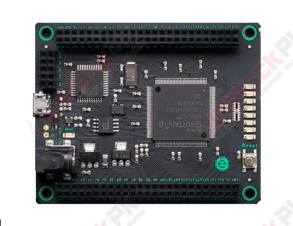
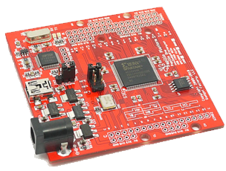
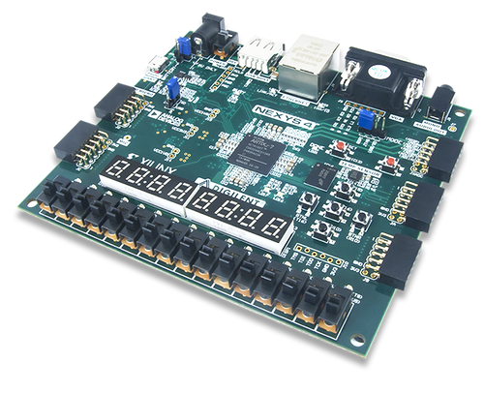
Boards we used
Board: Nexys DDR4 (Artix-7)
Max Freq: 280 MHz
Utilization: 0.36%
Cost: $265
Board: Mojo v3 (Spartan-6)
Max Freq: 88 MHz
Utilization: 52%
Cost: $74.99
Board: Papilio One 250k (Spartan 3E)
Max Freq: 50 MHz
Utilization: 73%
Cost: $37.99
Notes:
http://www.hddesktopbackgrounds.us/backgrounds-images/1920x1080/5amnf-desktop-56289262-1920x1080.jpg
Meiqi’s Slide

Slide 7
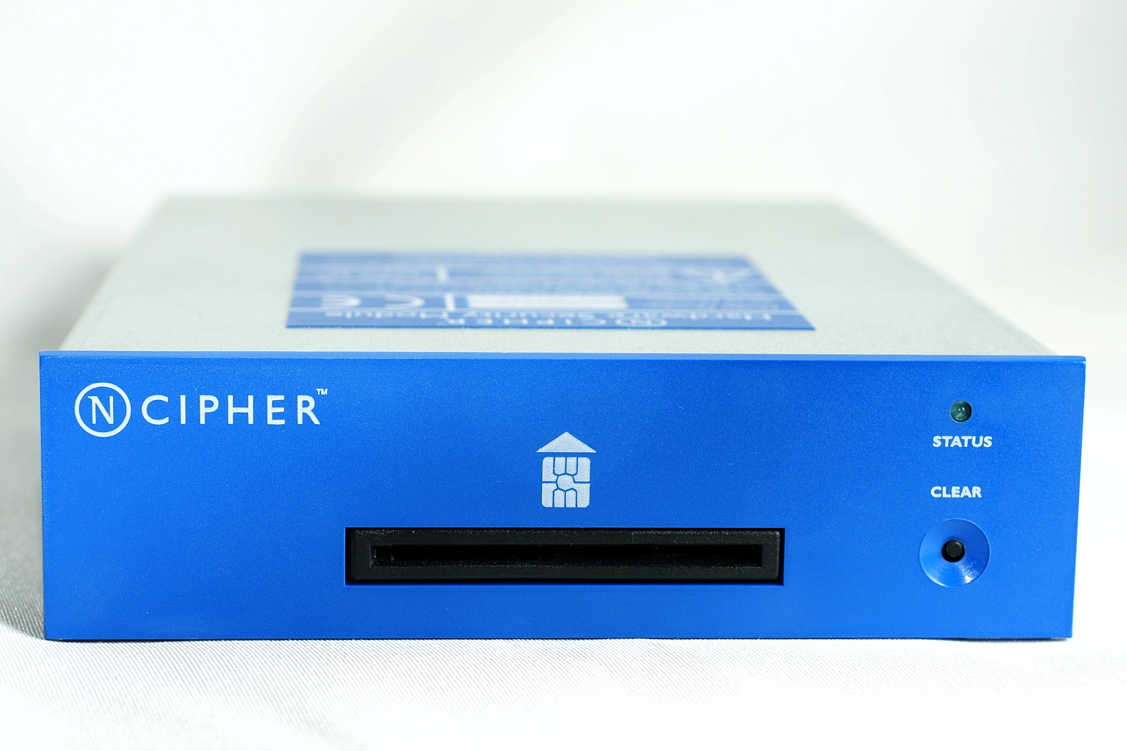
Alternate Approaches
Hardware encryption is usually done at the processor level
Used to protect vulnerable CPU resources
Dedicated hardware such as HSM (Hardware Security Modules)
Safeguard cryptographic keys and/or speed up crypto algorithms
Low-cost smart card or USB tokens are under $120
Limited to no support for cryptographic algorithms
Medium-cost to high-cost HSM is between $3,000 to $35,000
Large storage capability for key material
Secure but too much for the average consumer
Dickinson, S. and Rijswijk, R. (2012). HSM Buyers' Guide - Documentation Reference Material - OpenDNSSEC. [online] Wiki.opendnssec.org.
Notes:
http://www.hddesktopbackgrounds.us/backgrounds-images/1920x1080/5amnf-desktop-56289262-1920x1080.jpg
Meiqi’s Slide End Point

Slide 8
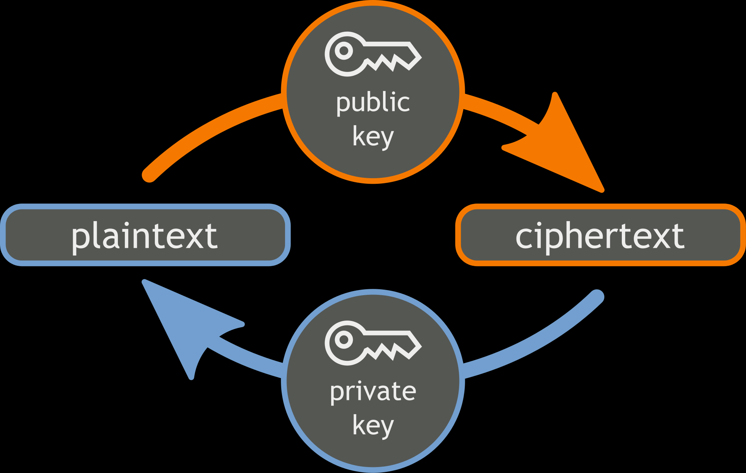
Cryptographic Algorithm AES-128
Advanced Encryption Standard (AES)
Performs symmetric encryption
Supports multiple fixed data block sizes
Origin of the code: GULPHAAC and libvcrypt
National Institute of Standards and Technology, “Announcing the ADVANCED ENCRYPTION STANDARD (AES).” Federal Information Processing Standards Publications, 26-Nov-2001. https://csrc.nist.gov/csrc/media/publications/fips/197/final/documents/fips-197.pdf
Notes:
http://www.hddesktopbackgrounds.us/backgrounds-images/1920x1080/5amnf-desktop-56289262-1920x1080.jpg
Dustin’s Slide Start Point

Slide 9
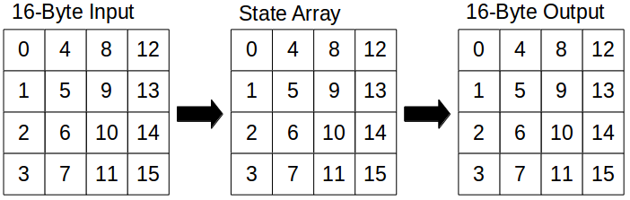
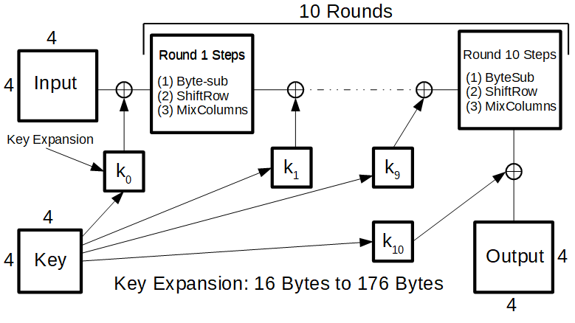
AES-128 Flow Diagram
Input/Output
128 bits (16 bytes)
Key
128 bits (16-bytes)
Key is expanded to be used by each round
Encryption Rounds (10 Rounds)
State: Operations performed on 2-D array of bytes
Byte-Sub: Nonlinear byte substitution
ShiftRow: Last 3 rows of the State are shifted
MixColumns: Operation on the State column-by-column
AddRoundKey: Expanded key for the round is added by bitwise XOR
Notes:
http://www.hddesktopbackgrounds.us/backgrounds-images/1920x1080/5amnf-desktop-56289262-1920x1080.jpg
Dustin’s Slide

Slide 10
Why use an FPGA?
FPGA vs. MCU
FPGA is > 3,000,000x faster
MCU doesn’t have enough resources to encrypt data and communicate to serial monitor concurrently
FPGA vs. x64
When using processors in laptops or desktops, results will be dependent on
No. of cores in use
Background apps/programs running
FPGA vs. GPU
GPU performance is 5x faster than FPGA
Infrastructure to wrap data and send to GPU for processing is cumbersome and expensive.
Notes:
http://www.hddesktopbackgrounds.us/backgrounds-images/1920x1080/5amnf-desktop-56289262-1920x1080.jpg
Dustin’s Slide

Slide 11

Methods Used
Verification
Testing properties with Cryptol
Running known-good test vectors through software and hardware
Benchmarking
Using software benchmarks created by OpenSSL
Throughput
Compare encryption throughput between different systems
Notes:
Benchmarking- Ran multiple tests using OpenSSL speed benchmarks… Calculated standard deviation to find out if the results were consistent… When we were satisfied with consistency in timing for system tested on, we used the data for our results
Dustin’s Slide
http://www.hddesktopbackgrounds.us/backgrounds-images/1920x1080/5amnf-desktop-56289262-1920x1080.jpg

Slide 12
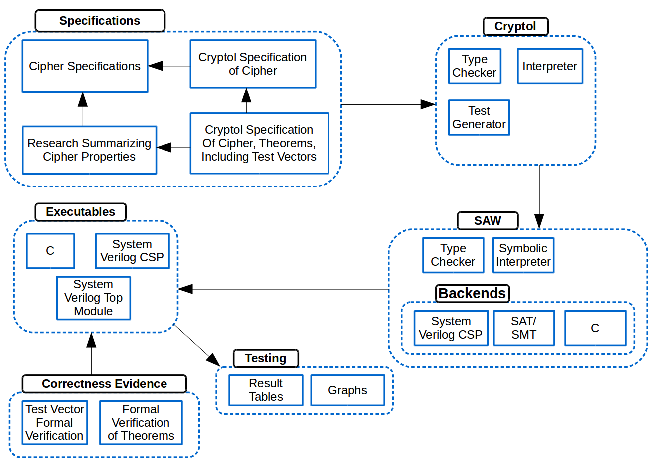
Software Flow Diagram
Notes:
http://www.hddesktopbackgrounds.us/backgrounds-images/1920x1080/5amnf-desktop-56289262-1920x1080.jpg
Dustin’s Slide

Slide 13
What we did : Cryptol and Benchmarks
Given aes.cry
Run Cryptol and use “check”, “prove’’ and “test” to verify that all the correctness of the algorithm
After verifying the correctness, use SAW to perform equivalence checking
Results from SAW and Cryptol confirms the accuracy of the aes model. Cryptol generated SV file was given
Given aes.c
Find AES-128 benchmark file from OpenSSL
Run benchmark to get approximate speed per encryption
Run on different systems and compare throughput with the FPGAs
Notes:
Dustin’s Slide End Point
http://www.hddesktopbackgrounds.us/backgrounds-images/1920x1080/5amnf-desktop-56289262-1920x1080.jpg

Slide 14
FPGA Implementation in Verilog
Design Flow
Simulation Synthesis Implementation
Module Design
Created a top module to pass data serially (RS-232)
Used FIFO buffers to store receive and transmit data
AES module provided by Galois encrypts the received data
Inputs: 128 bit plain text, 128 bit key
Output: 128 bit ciphertext
Tools Used
Vivado Design Suite for Artix-7 board
Yosys and Vivado ISE for Spartan-6 board
Picoblaze, Microblaze, and Digital Clock Manager for timing
Notes:
http://www.hddesktopbackgrounds.us/backgrounds-images/1920x1080/5amnf-desktop-56289262-1920x1080.jpg
Gomathy slide start

Slide 15
What we did : Verilog
Given Proc_AESencrypt,
aes_functions and SystemVerilog CSP
With the testbench, run simulation and verify the outputs are correct.
Since the file has channels and interfaces, change to inputs, outputs, reg and wire.
Synthesizing file with 128 bit vectors causes floorplanning and timing errors so create a new top module
Perform a frequency sweep to determine max threshold frequency at which there are no timing violations
Use Microblaze in the debugger mode, vary block RAM and distributed RAMs in use.
The output gets displayed on the RealTerm serial monitor.
This new top module is used to pass 8 bits(Tx) at a time serially then uses a parallel converter, encrypts data (Rx).
Determine maximum throughput for different development boards and compare them
Notes:
http://www.hddesktopbackgrounds.us/backgrounds-images/1920x1080/5amnf-desktop-56289262-1920x1080.jpg

Slide 16
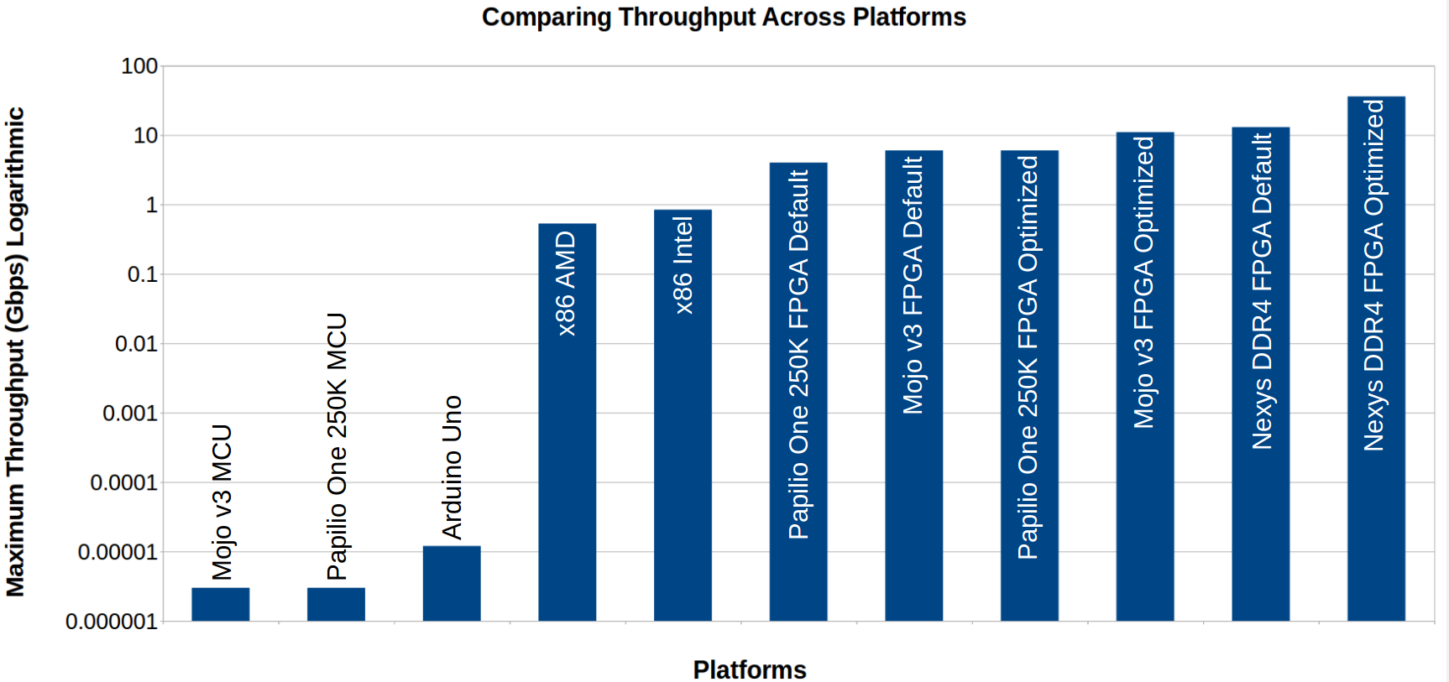
Performance Comparison
Notes:
This graph has been made based on the processing algorithm written in sv that process 8 bits at a time and by running benchmark file against the c file. (Technically its still processing 128 bits at a time)
Note: Maximum throughput is in Kbps for graphical representation reasons. (isn’t this in Gbps now?)

Slide 17
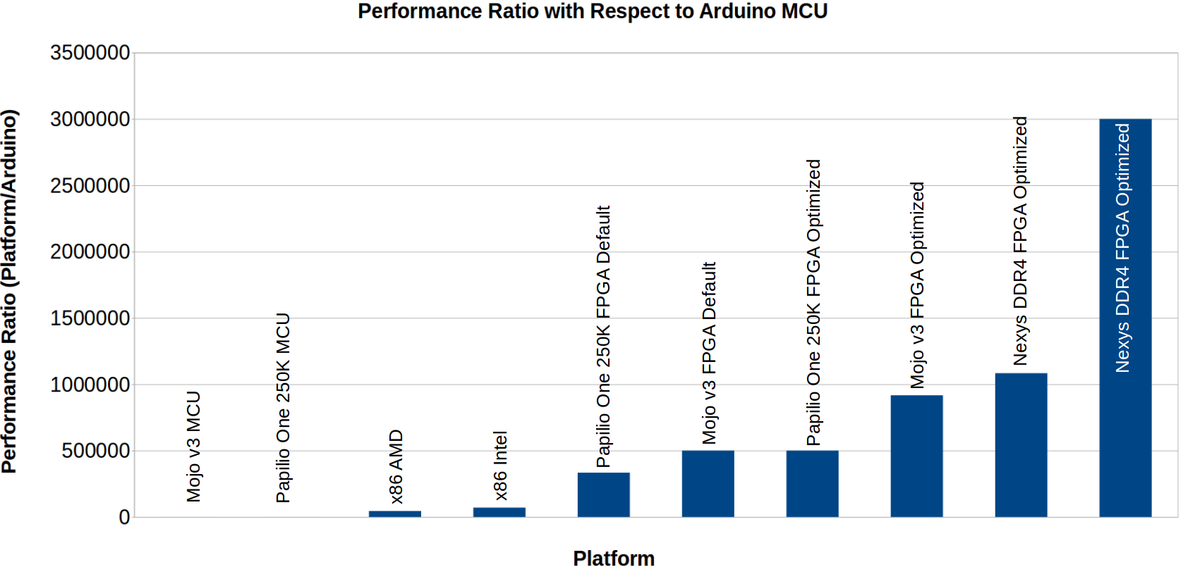
Performance Relative to Arduino Uno
Comparison with respect to the Arduino MCU.
Notes:
Comparison with respect to the Arduino MCU is done to show how almost any other platform is faster and is more efficient than the MCU with inadequate resources.

Slide 18
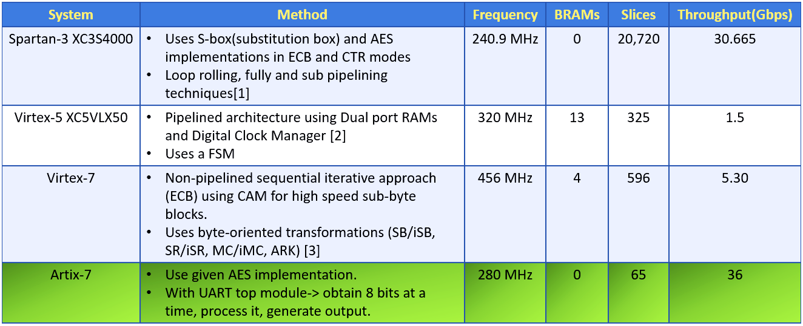
Related Work : FPGA
[1] https://www.sciencedirect.com/science/article/pii/S0141933115001040
[2]http://www.iaster.com/uploadfolder/2ImplementationoftheAES-128,AES-192OL25Sept13Copy/2Implementation%20of%20the%20AES-128,%20AES-192%20OL25Sept13%20Copy.pdf
[3] https://www.computer.org/web/csdl/index/-/csdl/proceedings/fit/2012/4946/00/4927a215.pdf
Notes:
http://www.hddesktopbackgrounds.us/backgrounds-images/1920x1080/5amnf-desktop-56289262-1920x1080.jpg

Slide 19
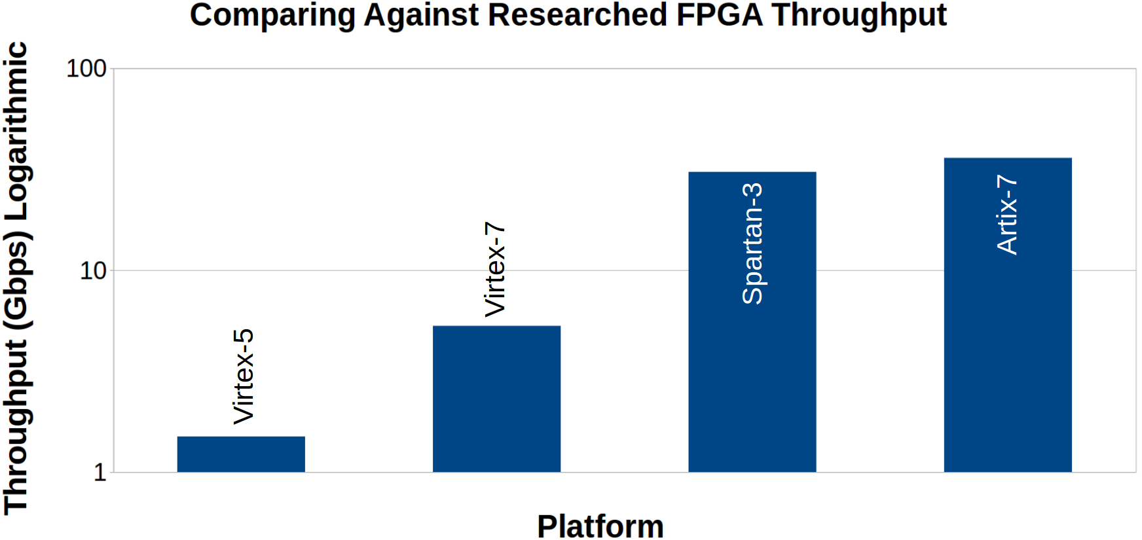
FPGA Throughput Comparison
Notes:
http://www.hddesktopbackgrounds.us/backgrounds-images/1920x1080/5amnf-desktop-56289262-1920x1080.jpg

Slide 20
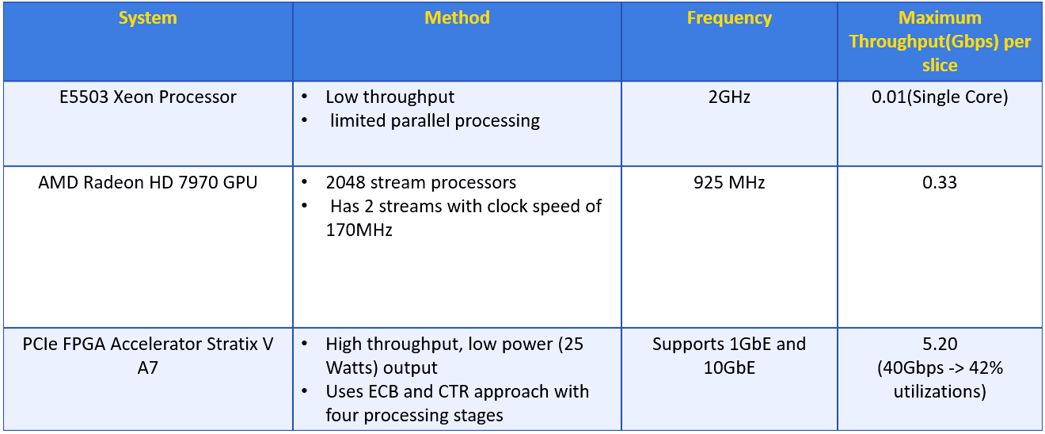
Related Work: Advanced Processors
AES encryption is described using FPGA OpenCL kernel and the performance figures reflect kernel processing time
https://www.altera.com/solutions/partners/partner-profile/isi-nallatech/board/385---pcie-fpga-accelerator-card.html
https://www.nallatech.com/40gbit-aes-encryption-using-opencl-and-fpgas/
Notes:
http://www.hddesktopbackgrounds.us/backgrounds-images/1920x1080/5amnf-desktop-56289262-1920x1080.jpg

Slide 21
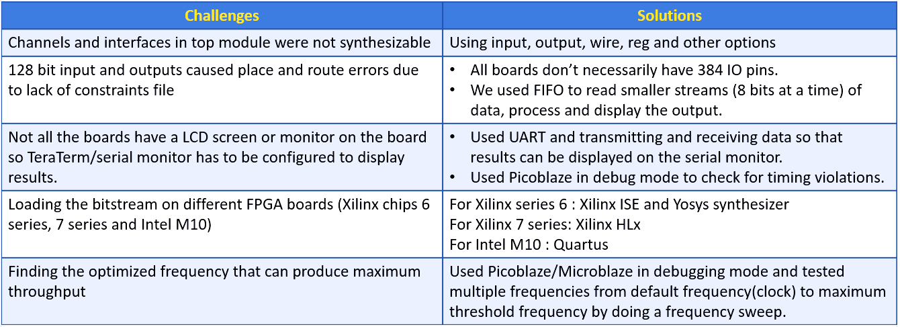
Challenges
Notes:
Gomathy’s Slide End Point

Slide 22
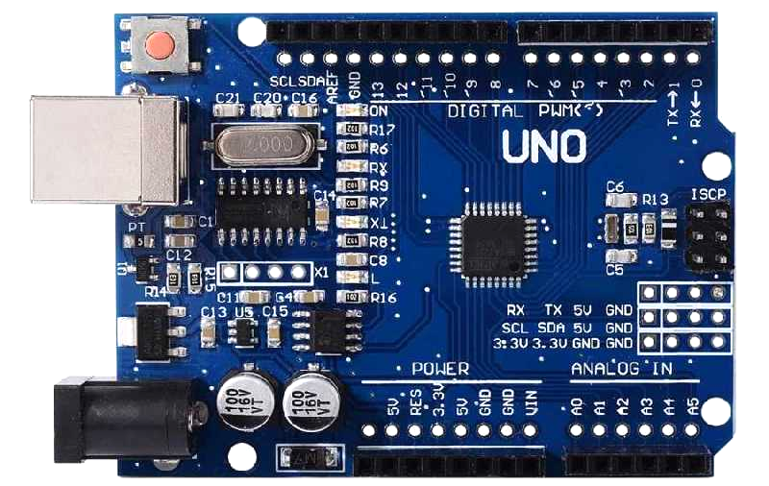
Conclusion
Encrypting data through an FPGA is faster than doing it through software
Around 100x of times faster than multi-core CPUs tested
AMD A10, Intel Xeon
Around 3,000,000x times faster than embedded MCUs
Arduino Uno, Mojo, Papilio- ATmega
Notes:
Ryan’s Slide Start Point

Slide 23

Knowledge Obtained Through the Struggle
Formal Verification takes a lot of work to get right
Secure crypto algorithms in software are surprisingly rare
Current Crypto APIs for software are not well documented
Keep adding to the Git repo
FPGA synthesis is not easy
Floorplanning and timing are a challenge
Tools are not easy to find for all devices
Notes:
http://www.hddesktopbackgrounds.us/backgrounds-images/1920x1080/5amnf-desktop-56289262-1920x1080.jpg
Ryan’s Slide- no corrections

Slide 24
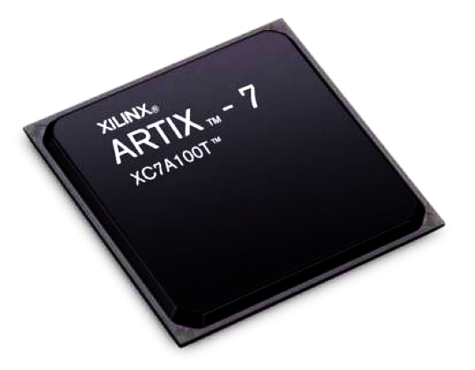
Knowledge Taken Away from the Project
FPGA design is challenging but also pretty fun
Hardware encryption has a lot of advantages over software
Usually less vulnerable due to limited user interaction
Faster due to dedicated resources
There are also disadvantages
Usually hardware encryption is less flexible and more difficult to implement
More work and higher cost ($30 - $300 for the boards we used)
Use FPGAs
Using FPGAs to do this makes the hardware more flexible
Notes:
http://www.hddesktopbackgrounds.us/backgrounds-images/1920x1080/5amnf-desktop-56289262-1920x1080.jpg
Ryan’s Slide- no corrections

Slide 25
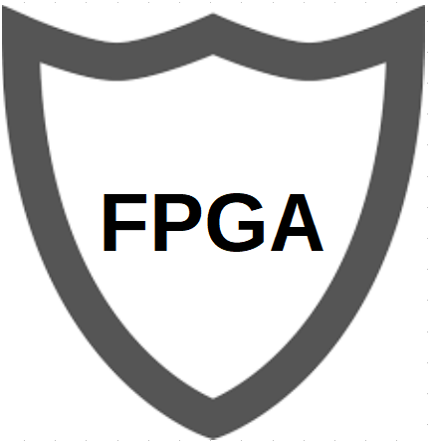
Future Plans
Implement other cryptographic algorithms using the same method
SHA-256, RNG
Optimize the code to get the best performance
Loop unrolling, pipelining, timing analysis
Design and create our own Arduino Uno compatible FPGA shield
Secure
Cost effective: < $100
Present the product to the public
Keep the Git repo and wiki up to date
Post on Hackaday and Crowdsupply
Notes:
http://www.hddesktopbackgrounds.us/backgrounds-images/1920x1080/5amnf-desktop-56289262-1920x1080.jpg
Ryan’s Slide- no more corrections

Slide 26
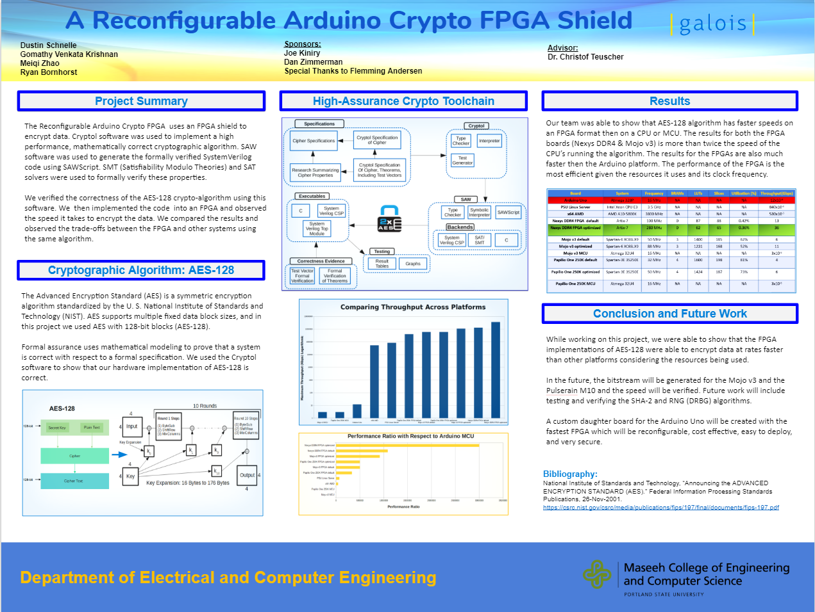
Poster
Notes:
http://www.hddesktopbackgrounds.us/backgrounds-images/1920x1080/5amnf-desktop-56289262-1920x1080.jpg
Ryan’s Slide- no corrections

Slide 27
Acknowledgements
Thank you to our sponsors Joe Kiniry & Dan Zimmerman of Galois
You both provided great guidance and knowledge for the group
Thank you to our faculty advisor Dr. Christof Teuscher
The weekly check-ins and advice kept the team focused
Special thank you to Flemming Andersen of Galois
The JasperGold session helped with the understanding of the Verilog code
Notes:
http://www.hddesktopbackgrounds.us/backgrounds-images/1920x1080/5amnf-desktop-56289262-1920x1080.jpg
Ryan’s Slide- no more corrections

Slide 28
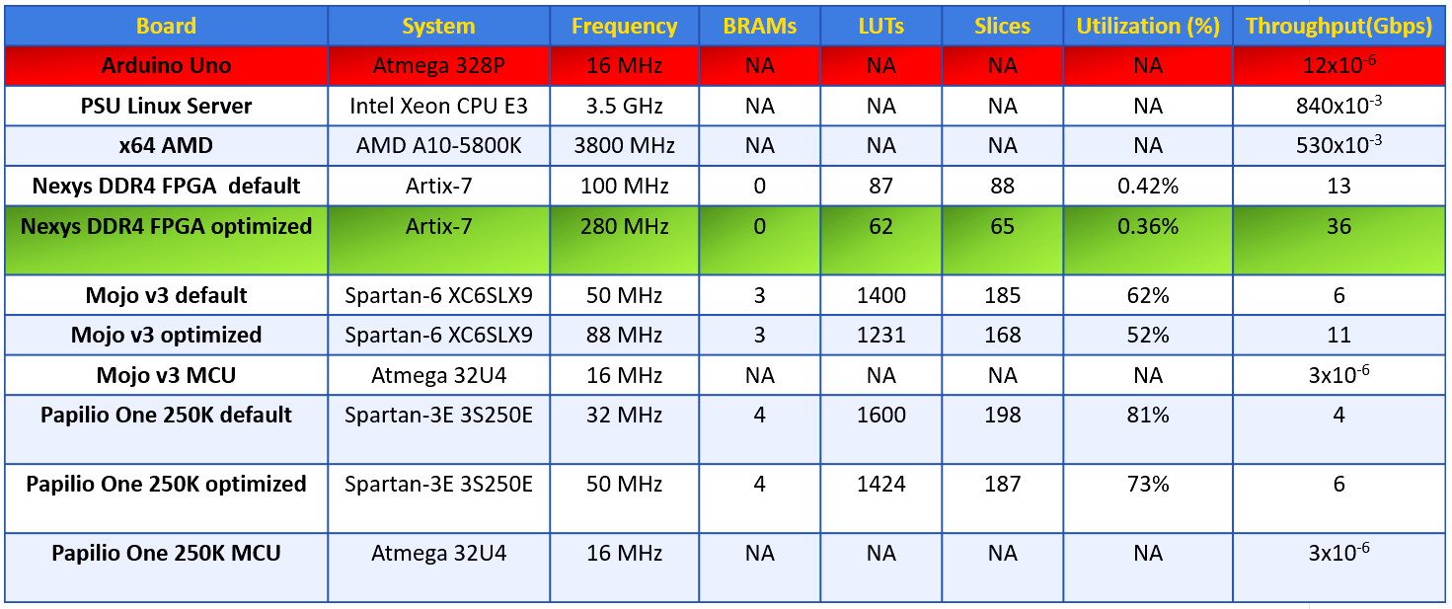
Questions?

Slide 29
Resources
Link to GitHub Repository
Project Proposal
Project Poster
Final Report
Notes:
http://www.hddesktopbackgrounds.us/backgrounds-images/1920x1080/5amnf-desktop-56289262-1920x1080.jpg
Ryan’s Slide End Point

